Slide 1
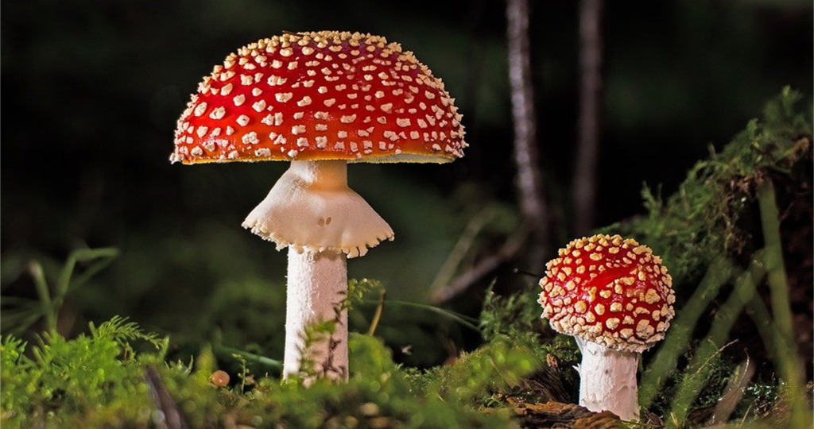
It Looks Delicious, isn’t it?

Slide 2
Classification of mushrooms into two categories; based on physical characteristics
This is a common and important problem in day-to-day life, we can use machine learning and data analysis, as accurately identifying poisonous mushrooms can be a matter of life and death in certain situations.
The data that comes for this task is the "Mushroom Data Set" from the UCI Machine Learning Repository.
Poisonous
Edible

Slide 3
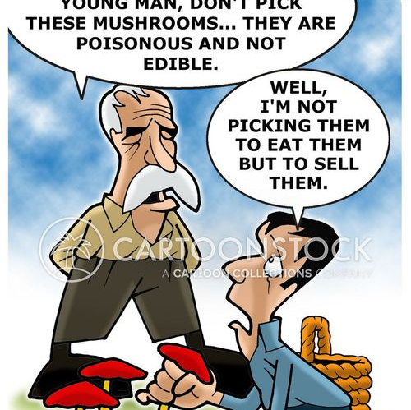
Modelling problem
A model that can predict whether a mushroom is poisonous, or edible based on its physical characteristics

Slide 4
Input Data
Physical characteristics of mushrooms.
cap color
cap shape
Odor
Gill size
gill color
habitat
stalk-shape
gill-attachment
spore-print-color
ring-type
ring-number
veil-type
veil-color
stalk-color-below-ring
bruises

Slide 5
Output Data
The output of the model is binary, representing whether the mushroom is "poisonous" or "edible."
This can be encoded as a binary, such as 0 for edible and 1 for poisonous.

Slide 6
Group Members
Shelani Hettiarachchi - IBMBB/BI/2023/007
W. Hashini Jayathunga – IBMBB/BI/2023/008
Shivashankari Kanthasami – IBMBB/BI/2023/009
Tharinda Karavita – IBMBB/BI/2023/010

Slide 7
Thank You

